Slide 1
Chapter 2-5 Chemistry Review

Slide 2
Question 1
Define matter, and give its 3 states.

Slide 3
1.Anything that has mass and takes up space.

Slide 4
Question 2
Explain the difference between a physical and chemical property.

Slide 5
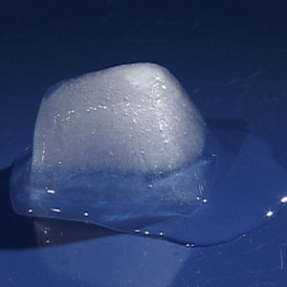
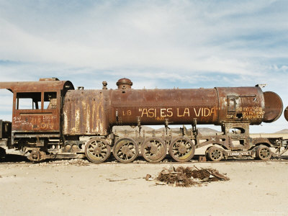
2.Physical-Can be observed with
senses
Chemical-Its ability to change

Slide 6
Question 3
List 3 examples of physical properties and 3 examples of a chemical property of a substance.

Slide 7
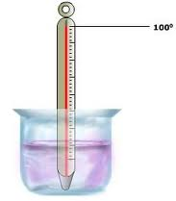
3.Physical: Odor, Color, Texture, Taste, Boiling Point, Density
Chemical: Reactivity, Flammability, Ability to Rust

Slide 8
Question 4
Explain the difference between a chemical and physical change.

Slide 9
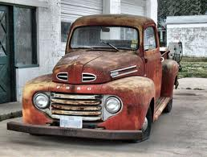
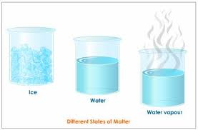
4.Chemical= New substance with new properties.
Physical= Changes form, but properties
remain the same

Slide 10
Question 5
Define the 3 types of matter.

Slide 11
Mixture-
Element-
Compound-

Slide 12
Mixture- 2 or more substances mixed but not chemically combined.
Element- A pure substance that cannot be broken down into other substances by chemical or physical means.
Compound- A pure substance made of two or more elements chemically combined.

Slide 13
6.Pure Substances are both_________ and __________. 7. What are atoms?_________________. 8. When matter changes, what is happening to energy within the substances?

Slide 14
6.Pure Substances are both Elements and Compounds. 7. What are atoms? Smallest particle of matter. 8. When matter changes, what is happening to energy within the substances? Energy is either being added or taken away.

Slide 15
Physical vs. chemical changes

Slide 16
When matter changes, what is happening to energy within the substances?

Slide 17
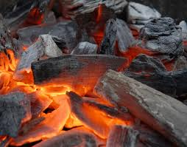
A change in energy happens to every change in matter.
In this picture it show charcoal burning. As it burns, it is releasing energy.

Slide 18
Define the following:

Slide 19
Melting-
Freezing-
Vaporization-
Condensation-
Sublimation-

Slide 20
Melting- The change from the solid to the liquid state of matter.
Freezing- The change from the liquid the solid state of matter.
Vaporization- The change of state form a liquid to a gas.
Condensation- The change from the gaseous to the liquid state of matter.
Sublimation- The change in state from a solid directly to a gas without passing through the liquid state.

Slide 21
Chapter 3
Changes in Matter

Slide 22
Question 1
For the 3 states of matter, draw how they would ‘move’ in a beaker, and explain in words their shape and volume in that container.

Slide 23
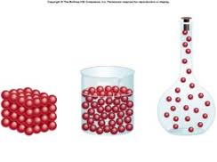
Solid liquid gas

Slide 24
2. In order for a change of state to occur, THERMAL energy is either added or taken away.

Slide 25
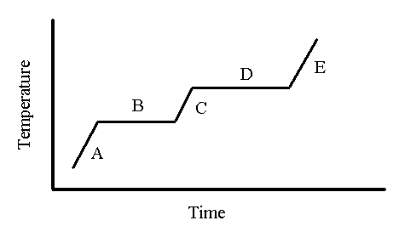
Textbook graph – p. 100

Slide 26
Textbook graph – p. 100
Solid water – A
Melting point – B
Boiling point – D
Highest energy - E

Slide 27
Chapter 4-The periodic Table

Slide 28
Fill out the following for the element oxygen: (be able to do for any element!)
Period
Family
# of protons
# of neutrons
# of electrons
# of valence electrons
Metal/nonmetal?
Oxygen
15.994

Slide 29
Fill out the following for the element oxygen: (be able to do for any element!)
Period 2
Family 6
# of protons 8
# of neutrons 8
# of electrons 8
# of valence electrons 6
Metal/nonmetal? nonmetal
Oxygen
15.994

Slide 30
2.Protons have a _______ charge, neutrons have a _______ charge, and electrons have a ________ charge.
3.Families are the _______ columns, while the periods are ________ rows.
4.Explain why families have similar characteristics____________________________________________________________________________.
5.What do valence electrons determine?_________________________________________________
6. Know where the metals, non metals, and metalloids are located on the periodic table.

Slide 31
2.Protons have a positive charge, neutrons have a neutral charge, and electrons have a negative charge.
3.Families are the vertical columns, while the periods are horizontal rows.
4.Explain why families have similar characteristics? Same number of valence electrons.
5.What do valence electrons determine? How atoms bond.
6. Know where the metals, non metals, and metalloids are located on the periodic table.
Left side of the periodic table.
On the zig zag line of the table
Right side of the periodic table.

Slide 32
List 3 traits of metals and 3 traits of non metals:
Non-Metals
1.________________
2.________________
3.________________
Metals
1.________________
2.________________
3.________________

Slide 33
List 3 traits of metals and 3 traits of non metals:
Metals
1. Shiny
2. Malleable
3. Conductors
Non-Metals
1. Dull
2. Brittle
3. non-conductors

Slide 34
Where are the alkali and alkaline earth metals located and what is special about them?

Slide 35
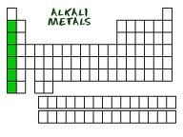
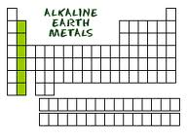
They are located the first 2 families, most reactive metals.

Slide 36
Where are the noble gases located and what makes them special?

Slide 37
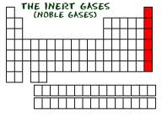
They are the last family, they are non-reactive -do not bond

Slide 38
Where are the semi-metals located and what makes them unique?

Slide 39
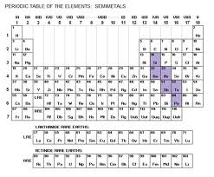
Touching the zig-zag line. They act as semi-conductors.

Slide 40
Chapter 5- Atoms and Bonding

Slide 41
1.In the nucleus of the atom are the _____ and ______, while the ________ orbit the nucleus.
2.During chemical reactions, what part of the atom is involved in bonding?
3.During a chemical reaction, electrons are either _____, ______, or ______.
4.What tells you the number of valence electrons in an atom?

Slide 42
1.In the nucleus of the atom are the protons and neutrons, while the electrons orbit the nucleus.
2.During chemical reactions, what part of the atom is involved in bonding? Valence Electrons
3.During a chemical reaction, electrons are either given, taken, or shared.
4.What tells you the number of valence electrons in an atom? Family Number

Slide 43
5. Draw an electron dot diagram for the following elements:
Na
O
C
Cl
Ne
Al

Slide 44
5. Draw an electron dot diagram for the following elements:
Na
O
C
Cl
Ne
Al

Slide 45
6. Explain the difference between a covalent and an ionic bond:___________________________.

Slide 46
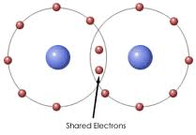
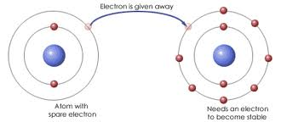
Covalent=share e-
Ionic= give/take e-.

Slide 47
7.How many valence electrons do most atoms want to be stable? (it’s the magic number!)

Slide 48
8

Slide 49
8. Atoms bond with other atom to ____ their valence electron shell and become more stable.
9. In a ionic bond, positive ions always bond with ________ ions.

Slide 50
8. Atoms bond with other atom to fill their valence electron shell and become more stable.
9. In a ionic bond, positive ions always bond with negative ions.

Slide 51
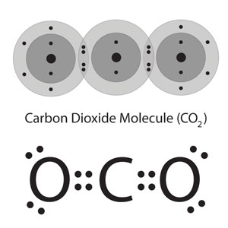
10. What type of bond is formed when atoms share valence electrons?

