Slide 1
Polymers and Life with Carbon

Slide 2
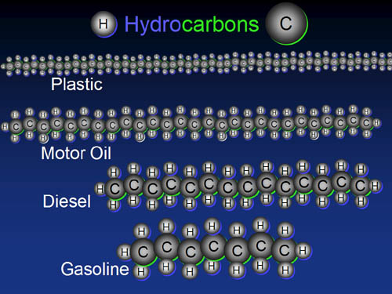
Polymers
Polymers are large complex molecules built from smaller molecules joined together in a repeating pattern.
Most polymers contain the element Carbon.
Carbon can form large molecules because:
1. it can make 4 covalent bonds
2. carbon can form straight chains, branched chains, and rings.
Ex of Polymers: DNA, cotton, plastics, polyester, nylon, starch, protein, carbohydrates.

Slide 3
Key question:
Seat #1 and #2
In the hot seat!
What element is found in almost all polymers and why??
Answer: carbon because it makes 4 bonds!!

Slide 4
Natural polymers
Cellulose, starch, silk, proteins, and cotton are examples of natural polymers.
You eat polymers daily in the form of carbohydrates, proteins, and fats.
Other natural polymers are used in fibers for their strength like silk and cotton.

Slide 5
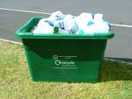
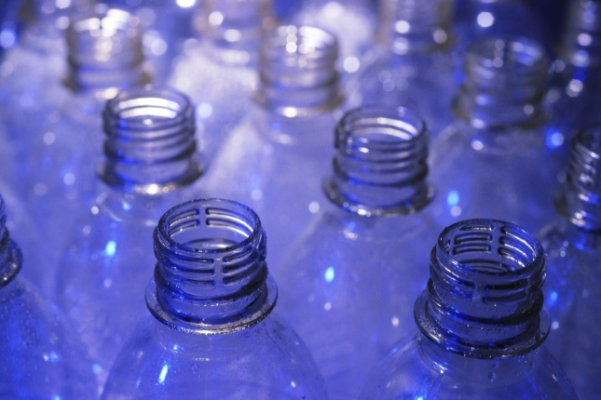
Synthetic polymers
Synthetic means ‘man made’
The most commonly used synthetic polymer is all forms of plastic.
Plastic and many synthetic polymers are made from oil or coal, both fossil fuels.
Ex of synthetic polymers: plastic, nylon, rayon, polyester, styrofoam, teflon.

Slide 6
Synthetic polymers

Slide 7
Key Question:
Seat #3 and #4
In the hot seat!
List 5 examples of polymers you see in our classroom, natural or synthetic:
Answer: your cotton shirt, plastic chair, plastic binder, water bottle, nylon shoe laces, fleece jacket, soap dispenser, etc…

Slide 8
Chapter 8 – Carbon Chemistry
Section 4 – Life with Carbon
Standards
6.a – Students know that carbon, because of its ability to combine in many ways with itself and other elements, has a central role in the chemistry of living organisms
6.b – Students know that living organisms are made of molecules

Slide 9
4 classes of organic compounds
We eat organic compounds daily for energy, growth, and to repair our bodies.
The 3 main groups of organic compounds required by living thing that we eat are:
Carbohydrates
Proteins
Lipids (fats, oils, and waxes)
Our cells make the 4th class of organic compounds: nucleic acids. (DNA and RNA)

Slide 10
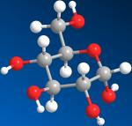
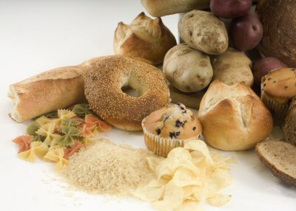
Carbohydrates
Carbohydrate – an energy-rich organic compound made of the elements carbon, hydrogen and oxygen
Simple carbohydrate – the simplest carbs are sugars (glucose is in your body – C₆H₁₂O₆) ex: fruit, sugar, fruit juice, yogurt, and milk all contain simple carbs.
Complex carbohydrate – a polymer made of smaller molecules that are simple carbs bonded to one another
Ex: bread, cereal, pasta, and potatoes
All contain complex carbs.

Slide 11
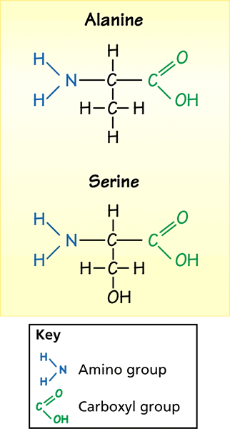
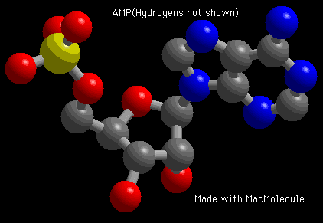
Proteins
Proteins – formed from smaller molecules called amino acids
Your muscles, hair, skin, and fingernails are all made of proteins.
Amino acid – a monomer that is a building block of proteins
Each amino acid molecule has a carboxyl group (–COOH) and an amino group (–NH₃)
The body uses proteins from food to build and repair body parts and to regulate cell activities
Examples of food with protein: meat, dairy, eggs, spinach, beans, and nuts.

Slide 12
Lipids
Lipids – energy-rich compounds made of carbon, oxygen and hydrogen
Lipids include fats, oils, waxes and cholesterol
Gram for gram, lipids release twice as much energy in your body as do carbohydrates
Ex of food sources with lipids: oil, red meat, dairy products, eggs, nuts, and butter
Saturated fats = have no double bonds, harder to break down.
Unsaturated fats = have double bonds, easier to break down.
Fatty acids – organic compound that is a monomer of a fat or oil
Cholesterol – a waxy lipid in animal cells used to build cell structures and acts as chemical messengers.

Slide 13
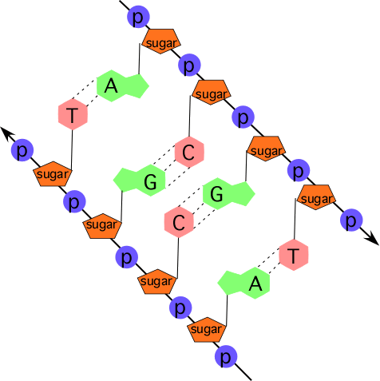
Nucleic Acids
Nucleic acids – very large organic molecules made up of carbon, oxygen, hydrogen, nitrogen and phosphorus
Two types – DNA and RNA
Elements that make up all living things…
C – Carbon
H – Hydrogen
N – Nitrogen
O – Oxygen
P – Phosphorus
S – Sulfur

Slide 14
Think/pair/share
Question: spend 1 minute thinking through this question:
How do we obtain these 6 essential elements (CHNOPS) into our body to create all of the necessary compounds and structures that make up our body?
Then Discuss at your table.

