Slide 1
Motion; Speed; Velocity; Acceleration
Physical Science
Vail Ranch Middle School

Slide 2
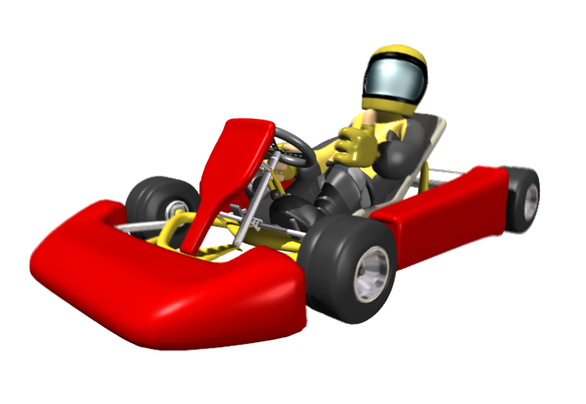
What Is Motion?
Motion is when an object changes place or position. To properly describe motion, you need to use the following:
Start and end position?
Movement relative to what?
How far did it go?
In what direction did it go?

Slide 3
What Is Speed?
Speed is the distance an object travels in a certain amount of time.
To calculate speed, you use the following formula:
Speed (s) = Distance (d)
Time (t)

Slide 4
Speed Math Problem
Suppose you ran 2 km in 10 min. What is your speed?
S = 2 km = 0.2 km/min
10 min

Slide 5
Another Problem
What is the speed of a car traveling 144 km in 2 hours?
________________ km/h

Slide 6
Solution
Speed = Distance
Time
144 km = 72 km/h
2 hours

Slide 7
Calculating Speed Given Distance & Time
Divide Distance by Time
Distance ÷ Time = Speed
Speed = Distance ÷ Time

Slide 8
Calculating Distance Given Speed & Time
Multiply Speed and Time
Distance = Speed X Time
Speed X Time = Distance

Slide 9
Finding Distance:
How far can a snail travel at 30 cm/hr in 6 hours?
D= S x T = 30 cm/hr x 6 hrs.
= 180 cm

Slide 10
Calculating Time Given Distance and Speed
Divide Distance by Time
Distance ÷ Speed = Time
Time = Distance ÷ Speed

Slide 11
Calculating Time
How long will it take the snail to cross the road that is 4 meters (400 cm) across traveling at a speed of 30 cm/hr?
T = D = 400 cm = 13.33 hours!! Or
S 30 cm/hr 13 hrs 20 min

Slide 12
Ways To Calculate Speed
Constant speed is when you are traveling at the same rate of speed, such as 55 mph constantly on a highway.
Average speed is taking the total distance traveled, and dividing by the total time it takes. Used for calculations that involve changing speed.
Instantaneous speed is the speed at any one given point in time.
Velocity – is the speed of an object in a given direction. Example – 25 km/h east

Slide 13
Brain Work!!
Question: Evens: Explain to your partner the difference between velocity and speed.
Question: Odds:
If I am traveling at 25 mi/hr and I turn left but maintain my speed, why is it that my velocity changes? Explain:

Slide 14
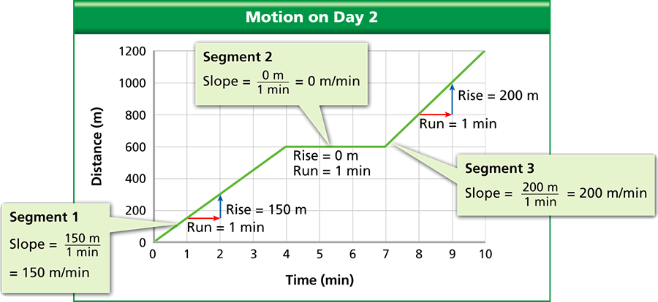
Graphing Speed
Slope – steepness of a line on a graph
Slope = rise / run
The slope of a distance vs time graph represents speed – the rate that distance changes in relation to time

Slide 15
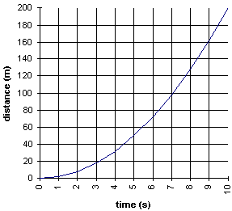
Graphing Speed
Plot distance against time to create a line graph of motion
Distance is on the vertical axis (y)
Time is on the horizontal axis (x)

Slide 16
Brain work!!
Q: What is the manipulated variable on the graph? What is the responding?
Label the variables on your notes.

Slide 17
Graph the following data
Distance
Time
30
40
50
60
90
15
20
30
50
60

Slide 18
Distance over Time

Slide 19
Velocity
Velocity is the speed of an object, but the direction is also included. It is calculated the same as speed, but you must include a direction in your answer.
Example: the bass boat was moving 12 mph toward the north.

Slide 20
Velocity Problem
Indicate which of the following are velocities:
125 cm/sec
30 km/h northwest
350m/sec north
520 km/h

Slide 21
Velocity Problem
Indicate which of the following are velocities:
125 cm/sec no
30 km/h northwest yes
350m/sec north yes
520 km/h no

Slide 22
Acceleration
Acceleration is the rate of change of velocity. A change in velocity can be either a change in speed, or direction, or both.
Deceleration is when acceleration has a negative value.

Slide 23
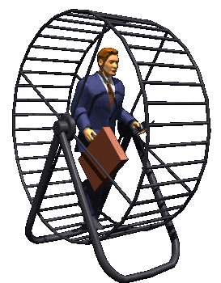
Acceleration
The formula for calculating acceleration is:
Acceleration (a) = final velocity (v_{f}) – initial velocity (v_{i})
time (sec)
The unit for velocity, in this case, is
m/s/s OR m/s²

Slide 24
Acceleration Math Problem
A jet starts at rest at the end of a runway and reaches a speed of 80 m/s in 20 s. What is its acceleration?

Slide 25
Acceleration Math Problem
A jet starts at rest at the end of a runway and reaches a speed of 80 m/s in 20 s. What is its acceleration?
Acceleration (a) = final velocity (v_{f}) – initial velocity (v_{i})
time (sec)
a = 80 m/s – 0 m/s = 4 m/s²
20 sec

Slide 26
Acceleration Math Problem
A skateboarder is moving in a straight line at a speed of 3 m/s and comes to a stop in 2 sec. What is his acceleration?
a = 0 m/s - 3 m/s = -1.5 m/s²
2 m/s

Slide 27
Homework Assignment
Copy this down – Assignment is due Friday:
Handout on calculating speed and velocity
Handout on average speed
Handout on acceleration

Slide 28
Forces
A force is a push or pull that one body exerts on another. A force can cause the motion of an object to change. There are two types of forces:
Balanced force – one in which the net force is zero.
Unbalanced force – one in which the net force has a numerical value.

Slide 29
Forces
Balanced Force
Net force = 0
+ 1 force
- 1 force
Unbalanced Force
Net force = -1
+ 1 force
- 2 force
Unbalanced Force
Net force = +2
+ 1 force
+ 1 force

Slide 30
Inertia
Inertia is the tendency of an object to resist any change in motion. Put in another way, if an object is moving, it will keep moving until an outside force acts on it.
Inertia is related to mass: the greater the mass of an object, the greater its inertia.

Slide 31
Newton’s 1st Law of Motion
Newton’s 1st Law is also known as the law of inertia. It says:
An object in motion will stay in motion, and an object at rest will stay at rest, unless acted upon by an outside force.
Example: if you are approaching a fence on a running horse, and the horse suddenly stops, you will keep going forward over the horse’s head unless you are wearing a seatbelt! (I don’t care who you are – that’s funny!)

Slide 32
Inertia
What does a seat belt do for us,
in terms of inertia?
-it helps us OVERCOME inertia!

Slide 33
The End!

