Slide 1
Grab it
review game

Slide 2
Around the World Tournament
Each round is 2 games. The winners in the first game play each other in the second game.
After a round, the table winner moves to the next table (9->8, 8->7). The table loser moves back a table.
Your goal is to be table winner of table 1 when we quit the game.

Slide 3
Force has two characteristics:
length and speed
mass and acceleration
magnitude and direction

Slide 4
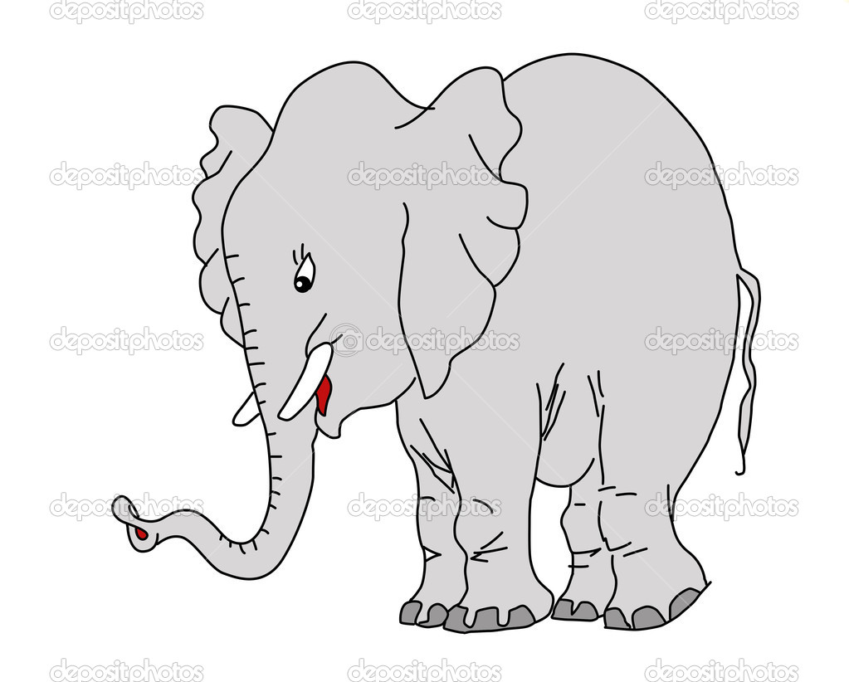
Solve: 100 N
300 N
200 N left
400 N left
200 N right

Slide 5
What happens when an unbalanced force is applied to an object?
The object accelerates
The object doesn’t move
The object travels at a constant speed

Slide 6
What 2 factors can change the force of friction?
Mass and inertia
Surface type and time
Surface type and mass

Slide 7
Static friction works on what type of objects
Objects with wheels
Objects that aren’t moving
Objects traveling at a rapid rate

Slide 8
What happens when 2 surfaces rub against each other?
Gravity
Friction
Acceleration

Slide 9
What is gravity?
The attraction between objects
The force moving downward
The acceleration of an object

Slide 10
You push with 80 N on the desk and your neighbor pushed with 60 N in the opposite direction. What happens?
The desk moves with 20 N force toward you
The desk doesn’t move
The desk moves with 20 N force toward your neighbor

Slide 11
What factors affect the strength of gravity?
Speed and inertia
Distance between objects and speed
Mass and distance between objects

Slide 12
Force is
a push or pull on an object
resistance to changes in motion
change in distance over change in time

Slide 13
Which is an example of sliding friction?
A skateboard on the road
Your feet running on the ground
Your dog swimming in a pool

Slide 14
Which is an example of rolling friction?
Sledding down a hill
Water skiing
Riding your bike

Slide 15
A combination of all the forces acting on an object is the
Net force
Balanced force
Mass

Slide 16
Which is an example of fluid friction
Air resistance
Walking on the grass
Driving a car on the highway

Slide 17
What units are used to measure force?
Pressure
Newtons
Kilograms

Slide 18
When forces act in the same direction you _____ them together
Subtract
Add
Multiply

Slide 19
The tendency to resist changes in motion is
Laziness
Gravity
Inertia

Slide 20
How does mass effect inertia?
more mass = more inertia
less mass = more inertia
mass has no affect on inertia

Slide 21
Newton’s 3rd law state that for every action, __________
there are consequences
the force accelerates
there is an equal and opposite reaction

Slide 22
What is the formula for momentum?
mass x inertia
mass x acceleration
mass x velocity

Slide 23
Which is an example of tension
squeezing a teddy bear
pulling a fishing line
sitting on the sofa

Slide 24
Conservation of momentum means that without outside forces, the total momentum of colliding objects...
remains the same
is reduced by half
is increased 10 times

Slide 25
What is weight?
The amount of matter in your body
The force of gravity acting on objects on the surface of a planet
The net force acting on you

Slide 26
What does Newton’s 2nd law tell us about acceleration?
Increase in mass = decrease in acceleration
Increase in force = decrease in acceleration
Increase in mass = increase in acceleration

Slide 27
What is free fall?
When the only force acting on a falling object is gravity
When the total forces acting on you are stronger than gravity
When you fall out of an airplane

Slide 28
Which is an example of compression?
tightening guitar strings
dropping an orange
squeezing a sponge

Slide 29
What is the formula for acceleration?
force x mass
force + mass
force / mass

Slide 30
A bowling ball with a mass of 5 kg is moving at a speed of 5 m/s. What is it’s momentum?
10 kg x m/s
25 N
25 kg x m/s

Slide 31
A .2 kg baseball is hit with 20 N of force. What is it’s acceleration?
4 m/s²
100 m/s²
100 kg

Slide 32
A 5 kg bowling ball accelerates at a speed of 2 m/s^{2.} What force does it hit the pins with?
10 N
10 m/s²
2.5 N

Slide 33
Which has the greater momentum?
a heavy truck at rest
a skateboard traveling at 5 m/s
a human running at 5 m/s

Slide 34
When you kick a soccer ball, the action force is you pushing the ball, the reaction force is:
the ball moving
the ball pulling your foot
the ball pushing your foot

Slide 35
What 2 ways could I accelerate a wagon?
increase mass or increase force
decrease mass or increase force
decrease mass and decrease force

Slide 36
When playing pool, the cue ball hits a colored ball, and momentum is...
transferred and conserved
increased
decreased

