Slide 1
Friction and Gravity Notes

Slide 2
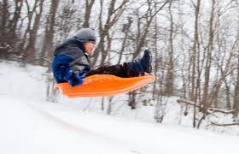
Newton’s 1st law – p. 380
Remember, an object in motion tends to stay in motion, an object at rest tends to stay at rest unless acted on by an outside force.
The 2 most common outside forces on earth are: FRICTION AND GRAVITY
Friction: The force that two surfaces exert on each other when they rub against each other.

Slide 3
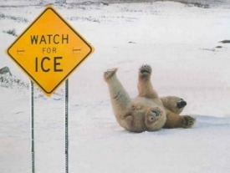
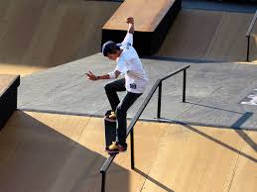
Causes of Friction
The strength of the force of friction depends on the types of surfaces involved and how hard the surfaces are pushed together.
The rougher the surface, the greater the friction. Ex: carpet vs wood floor, Asphalt vs. ice.

Slide 4
Increasing Friction
Friction also increases when the surfaces are pushed together with more force. Ex: rub hands together and increase force. More mass, more force.
The heavier the box, the greater the friction!

Slide 5
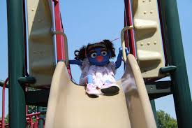
Types of Friction
4 Main types of Friction
Static friction – the friction that acts on objects that are not moving. This is the friction you overcome to start moving an object.
Sliding friction – when 2 solid surfaces slide over each other. Ex: pushing a box, sliding
Static friction between the box and the ground before it moves

Slide 6
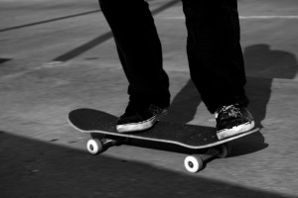
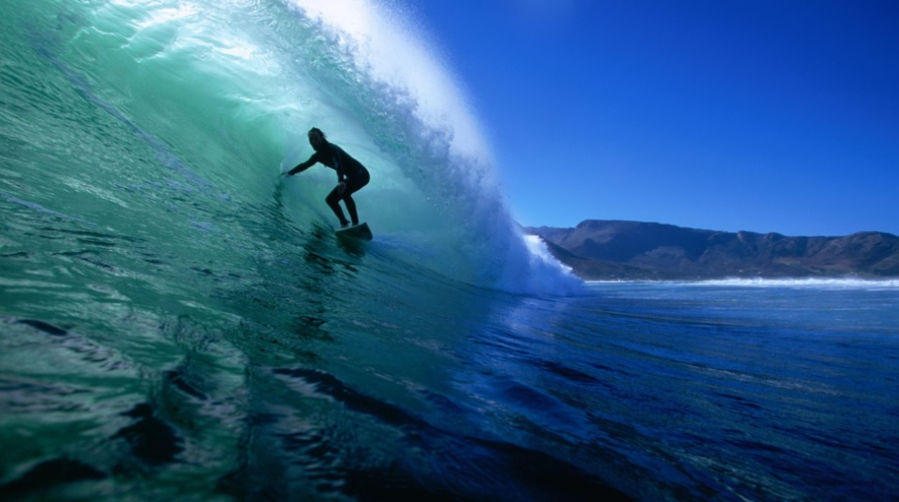
Types of Friction
3. Rolling friction – when an object rolls across a surface. Ex: anything with wheels.
4. Fluid friction – when a solid object moves through a fluid. Ex: swimming, air resistance.

Slide 7
Gravity
Gravity is the force that pulls objects toward each other.

Slide 8
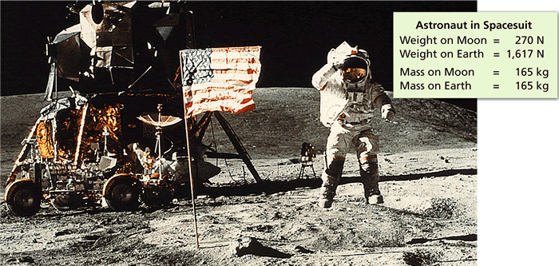
Gravity and Weight
The gravitational force exerted on a person or object at the surface of a planet is known as weight.
Weight = mass x acceleration due to gravity
Acceleration due to gravity: 9.8 m/s²

Slide 9
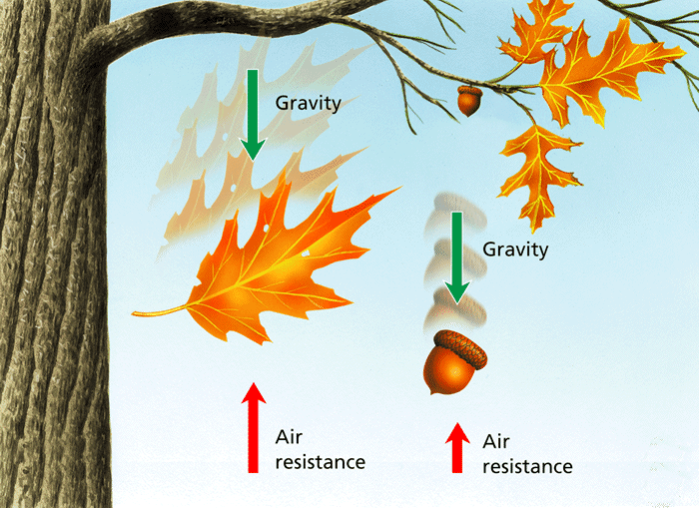
Gravity and Motion
Freefall – when the only force acting on an object is gravity. This only occurs in the vacuum of space or a vacuum chamber.
Air resistance – the force that opposes gravity on a falling object. This is a type of fluid friction

