Slide 1
Chapter 6-7 Chemistry Final Review

Slide 2
Question 1.
What are the 5 signs that a chemical change has occurred?

Slide 3
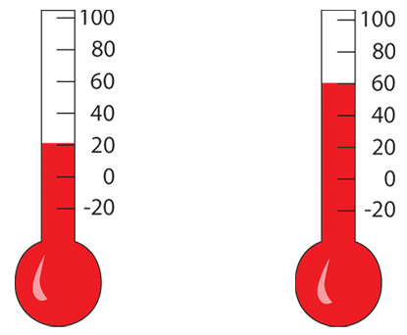
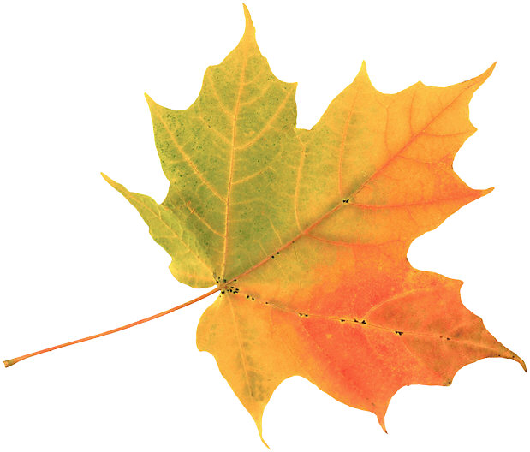
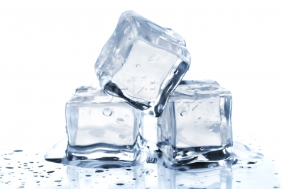
Answer 1.
Color change
Temp. change
Gas production
Precipitate forms
Change in prop.

Slide 4
Question 2.
Fill in the blank.
Chemical reactions occur when bonds are either ______ or ______.

Slide 5
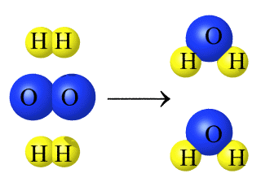
Answer 2.
Chemical reactions occur when bonds are either broken or formed

Slide 6
Question 3.
Fill in the blank.
When chemical reactions occur, atoms are not created or destroyed, they are just re-________

Slide 7
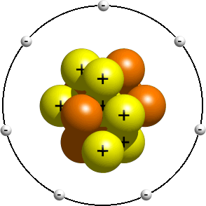
Answer 3.
When reactions occur, atoms are not created or destroyed, they are just re-arranged

Slide 8
Question 4.
What do chemical formulas and chemical equations show?

Slide 9
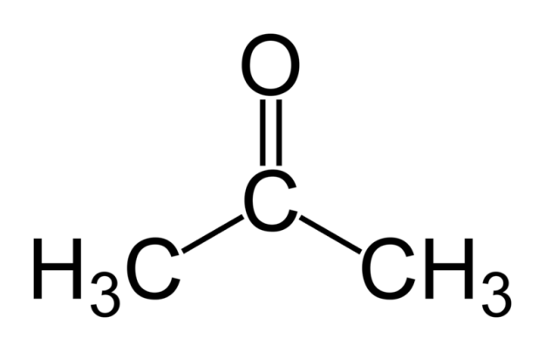
Answer 4.
Chemical formulas show the elements and ratio of atoms in a molecule
Chemical equations show the reactants and resulting products of a reaction

Slide 10
Question 5.
Which are the reactants, products, coefficient, and subscripts?
2H²O → 2H² + O²

Slide 11
Answer 5.
coefficients
reactants
subscripts
products

Slide 12
Question 6.
Balance the following equations:
HCl + NaOH → H²O + NaCl
Fe²O³ + C → Fe + 3CO²
Zn + HCl → ZnCl + H²

Slide 13
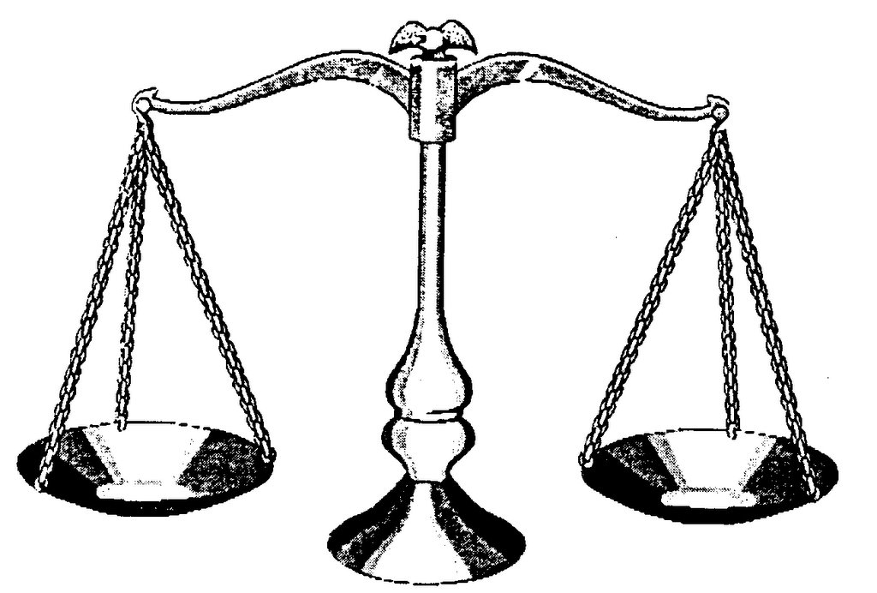
Answer 6.
HCl + NaOH → H²O + NaCl
2Fe²O³ + 3C → 4Fe + 3CO²
2Zn + 2HCl → 2ZnCl + H²

Slide 14
Question 7.
What are
thermic and
endothermic reactions?

Slide 15
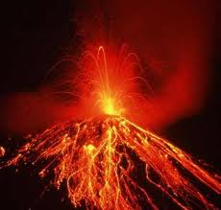
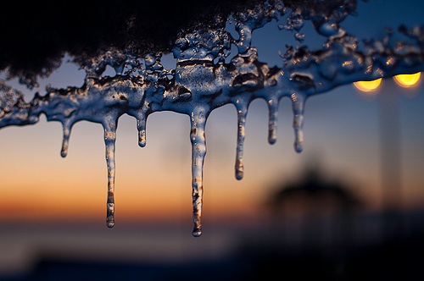
Answer 7.
An exothermic reaction is a reaction that releases energy in the form of heat
An endothermic reaction is a reaction that absorbs energy

Slide 16
Question 8.
What is the amount of energy required to start a reaction?

Slide 17
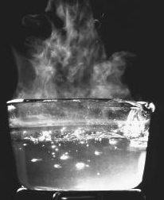
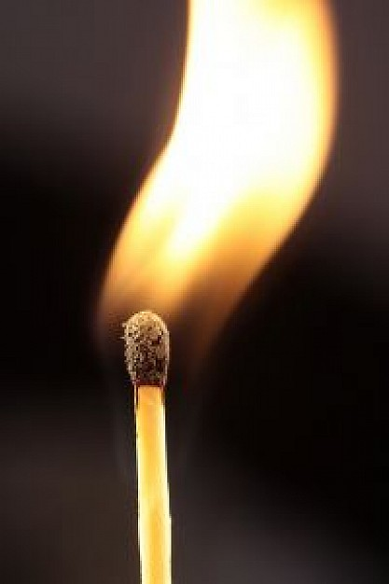
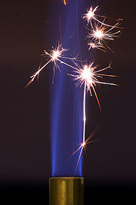
Answer 8
Activation Energy

Slide 18
Question 9.
What are the 4 things that can affect the rates of chemical reactions?

Slide 19
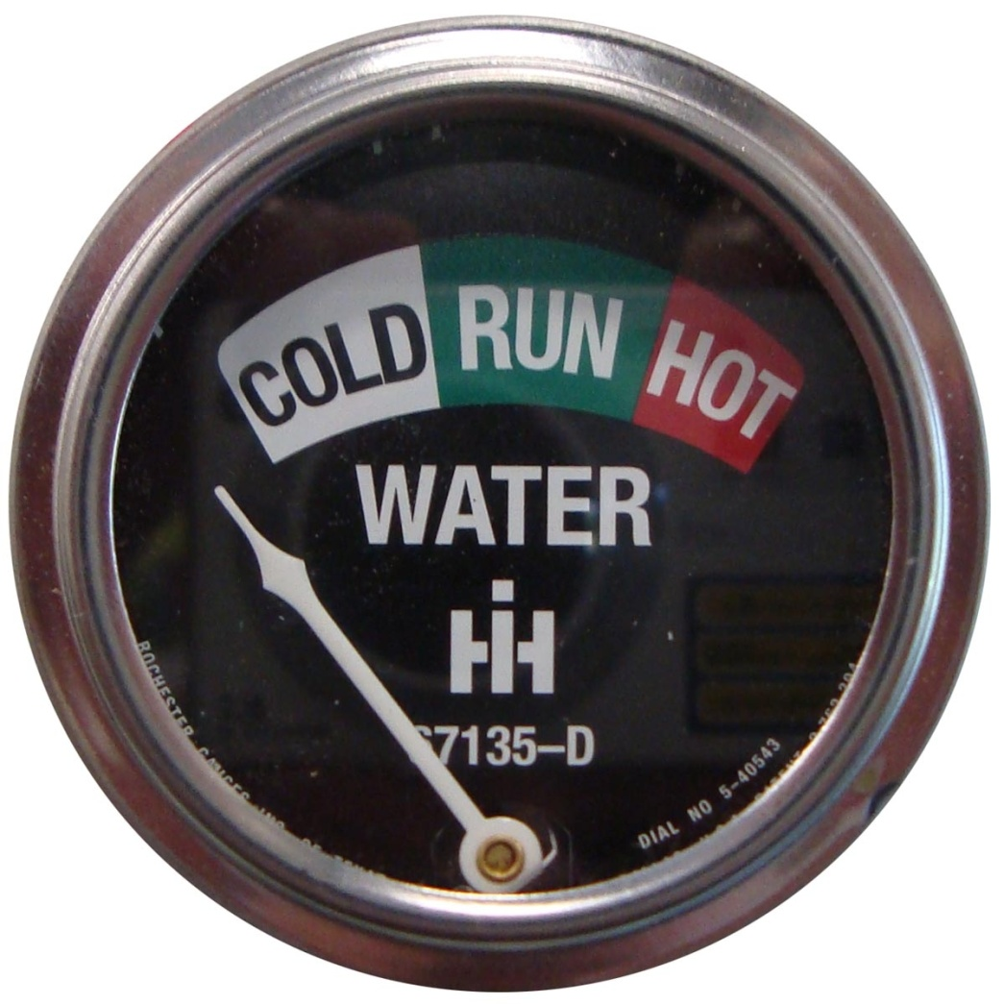
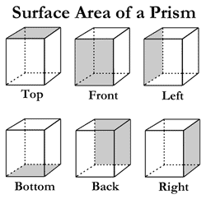
Answer 9.
Temperature
Surface Area
Concentration
Catalysts

Slide 20
Question 14.
What are double bonds and triple bonds?

Slide 21
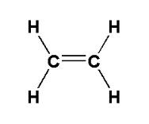
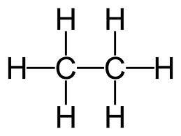
Answer 14.
A double bond is sharing 2 pairs of electrons
A triple bond is sharing 3 pairs of electrons

Slide 22
Question 17.
What are the characteristics of acids and bases?

Slide 23
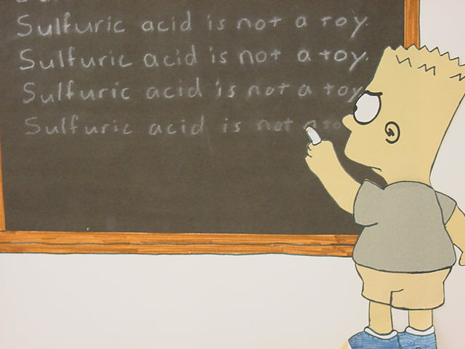
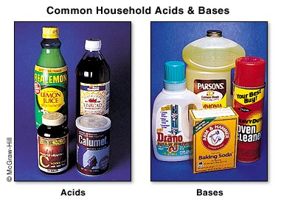
Answer 17.
Acids
Sour
Corrosive to metals
Bases
Bitter
Slippery

Slide 24
Question 18.
What is the pH range of acids and bases?

Slide 25
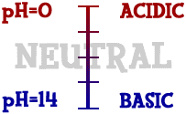
Answer 18.

Slide 26
Question 19.
What are the colors that acids and bases turn litmus paper?

Slide 27
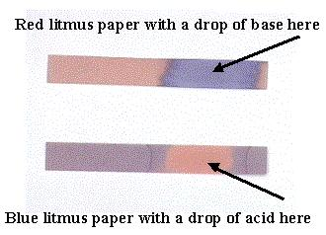
Answer 19.

Slide 28
Question 20.
What are 5 examples of acids and bases, and what are the types of ions they produce in water?

Slide 29
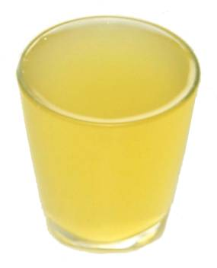
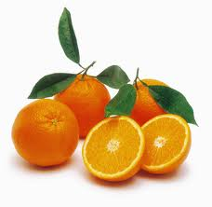
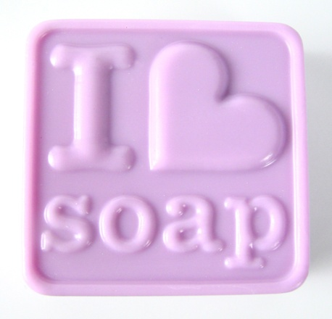
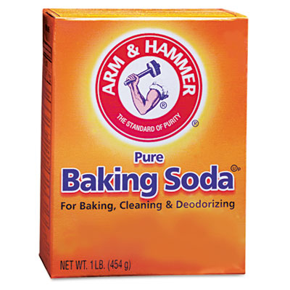
Answer 20.
Acids
Lemon Juice
HCl
Coffee
Oranges
Battery Acid
Produces H+ ions
Bases
Soap
Baking Soda
Drain Cleaner
Windex
Ammonia
Produces OH- ions

Slide 30
Question 21.
The stronger the acid, the _____ the pH, the stronger the base, the ______ the pH

Slide 31
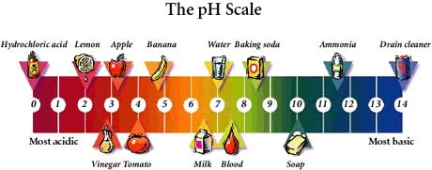
Answer 21.
The stronger the acid, the lower the pH, the stronger the base, the higher the pH

Slide 32
Question 22.
What does a neutralization reaction produce?

Slide 33
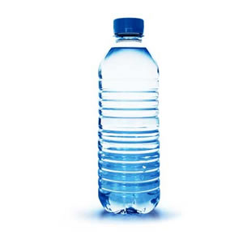
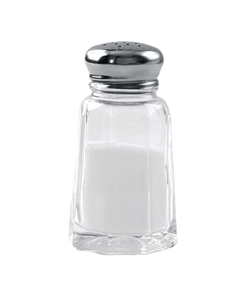
Answer 22.
&

