Slide 1
Chapter 4 Periodic Table

Slide 2
Matter
All the ‘stuff’ of the universe is composed of Matter. Ex: air, you, your table, a pencil, a star, etc…
Matter – anything that has mass, and takes up space.
The smallest particle of matter is an atom.
The structure of the atom determines the traits of matter.
Ex: Aluminum is different than Gold because it’s atoms are different.

Slide 3
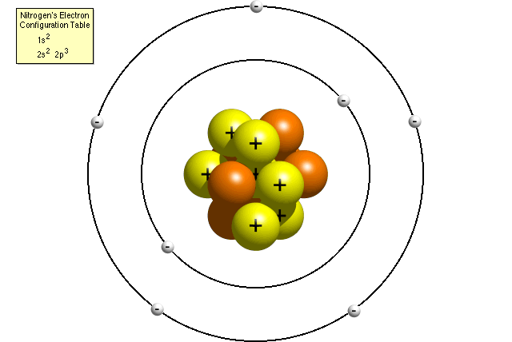
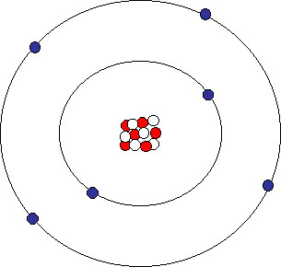
Atoms
An atom consists of 3 main parts: protons, neutrons, and electrons.
Protons and neutrons are in the nucleus (the center of the atom), while electrons orbit the nucleus. (like planets around our sun)
Protons have a positive charge (+), neutrons are neutral (0), while electrons have a negative charge (-).

Slide 4
Structure of an Atom
Important parts of the atom:
Subatomic Particle | Symbol | Charge | Mass | Location
Proton + Positive 1 amu Nucleus
Neutron N Neutral 1 amu Nucleus
Electron e- Negative 0 amu Electron
Cloud

Slide 5
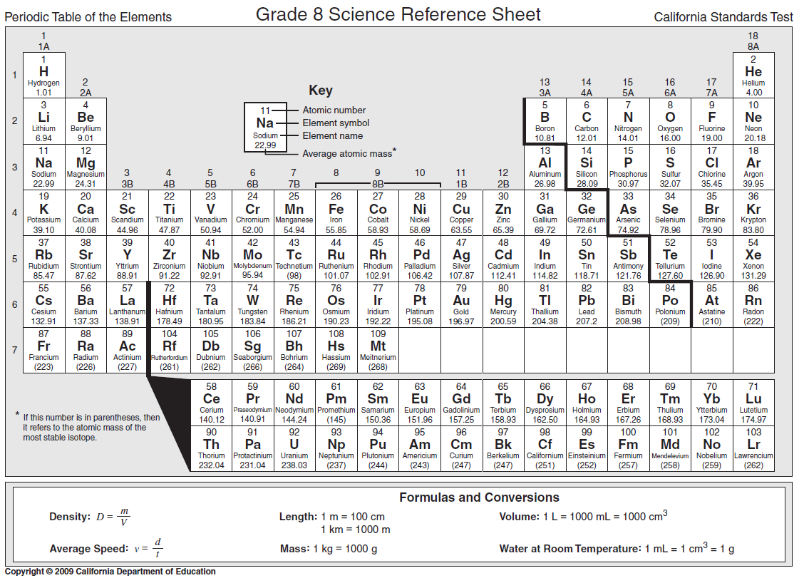
The Periodic Table
All matter in the universe is made up of elements.
The periodic table organizes the elements by atomic number (the # of protons in the nucleus).

Slide 6
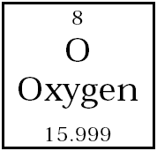
The Periodic Table
Atomic Number = # of protons in the nucleus (this is what defines the element)
Atomic Mass = sum of protons + neutrons in nucleus
In an atom, the number of protons (+) are equal to the number of electrons (-) – so the charges balance out and the atom has a neutral overall charge
Atomic Number
Chemical Symbol
Chemical Name
Atomic Mass

Slide 7
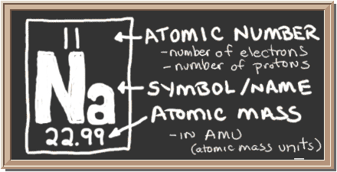
Reading the Element Square
To find the number of protons: it’s the same as the atomic number
To find the number of electrons: it’s the same as the atomic number
To find the number of neutrons:
Atomic Mass
- Atomic number___
# of neutrons

Slide 8
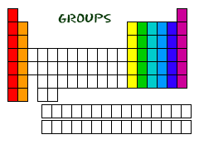
Families
Families or groups are in vertical columns (18) and elements in a family have similar traits or properties.
Elements in a family can make the same number of bonds and so have similar chemical properties

Slide 9
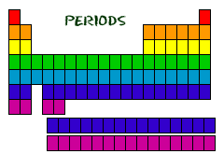
Periods
Periods are the horizontal rows are elements in a period DO NOT have similar properties.
Elements in a period have the same # of electron shells.

Slide 10
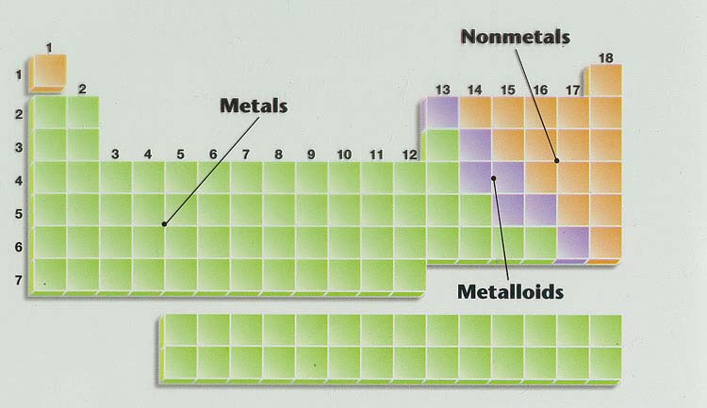
Periodic Table
Elements are also classified as metals, nonmetals or metalloids according to their properties
The zig zag line on the table separates these categories
To the left: metals To the right: non-metals
Touching the zig zag line= metalloids

Slide 11
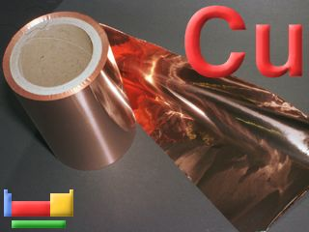
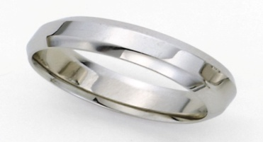
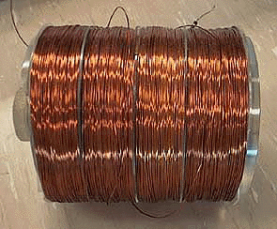
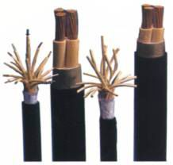
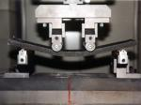
Properties of Metals
Metals have similar physical properties. They are:
Shiny
Malleable – can bend or pound into shapes
Ductile – can form into wires
Good conductors of heat and electricity
High melting points
Hard
Chemical properties can vary. Some can corrode, and some are very reactive –
form bonds.

Slide 12
Properties of Non-metals
Non-metals have the opposite properties of metals. They are:
Dull
Brittle
Non-conductive (Insulators)
Low melting points
Mostly gases at room temperature
Chemical properties:
All non-metals can form compounds except the noble gases (family 18).
Noble gases (inert gases) – the last family on the periodic table that does not react with anything. They are the snobs of the table. Ex: helium, neon

Slide 13
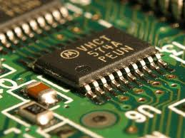
Properties of Semi-metals
The semi-metals (also called metalloids) can have properties of both metals and nonmetals.
Their most useful property is that they are semi-conductors.
Semi-conductor – the varying ability to conduct electricity. Used in every computer chip in the world.
Example: silicon

